Slide 1
Sales Dashboard Design and Insights
-By Jasdeep Kaur

Slide 2
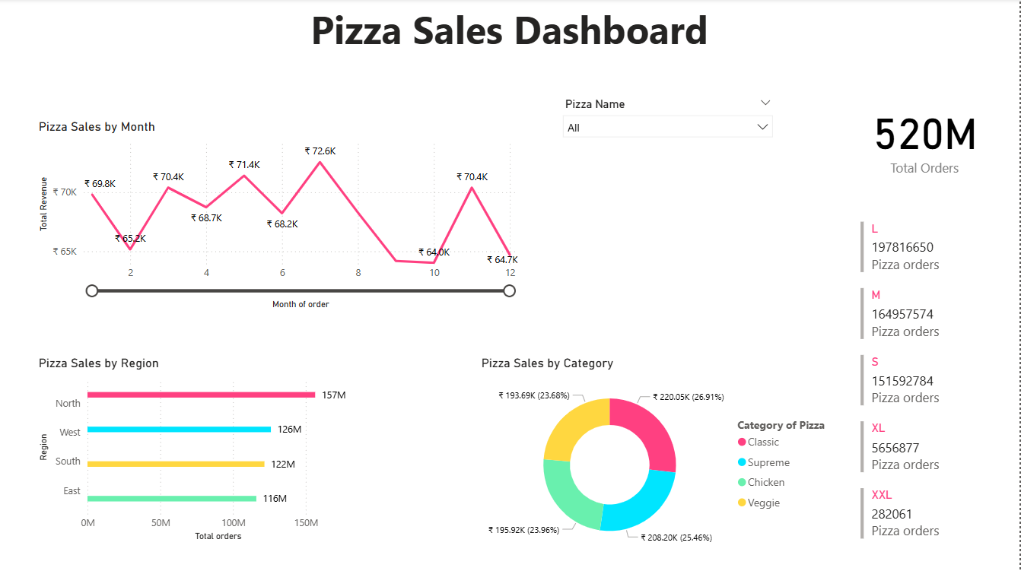

Slide 3
Insights
Total numbers of pizzas ordered in 2015 is 520 million.
All pizza categories were sold almost as much as each other, but the highest selling category of pizza is “Classic”.
The most wanted size of pizza is “Large” followed by “Medium”, “Small”, “Extra Large”, “Extra Extra Large”.
Highest Revenue of pizzas was in 7th month ,i.e. July, of 2015 amouting to ₹ 7,25,57.9 with 51 million orders.

Slide 4
THANK YOU !!

